Slide 1
Survey Results on Chancellor’s $3 Million Compensation Proposal
Prepared by Peter Hart-Brinson for United Faculty and Academic Staff
Presented Thursday, October 27, 2016

Slide 2
Outline
Background
Merit vs. Equity
Morale
Merit
Equity
Living Wage
Future Allocations
Motion

Slide 3
Background
Based on Chancellor Schmidt’s August 31 presentation
Four members of United Faculty and Academic Staff collaborated to design 11-item survey
Distributed to all employees on campus via campus mail (1259 copies printed)
Open from September 11 – October 20
Collected n=251 responses

Slide 4
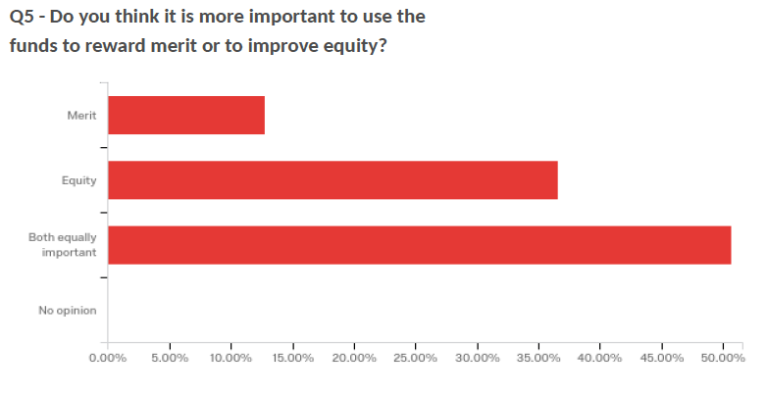
Merit vs. Equity

Slide 5
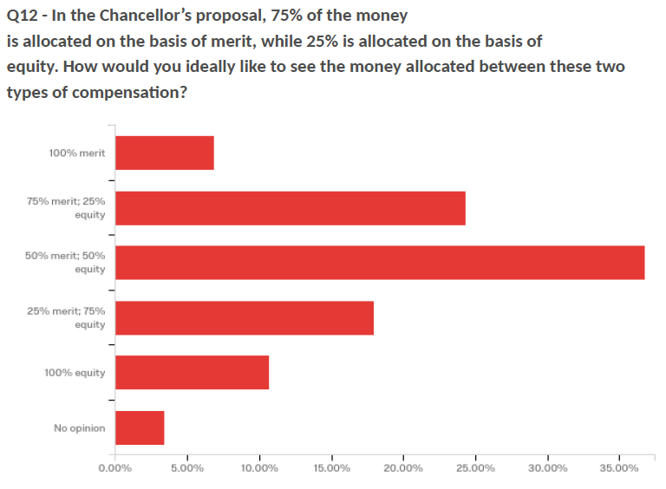
Merit vs. Equity

Slide 6
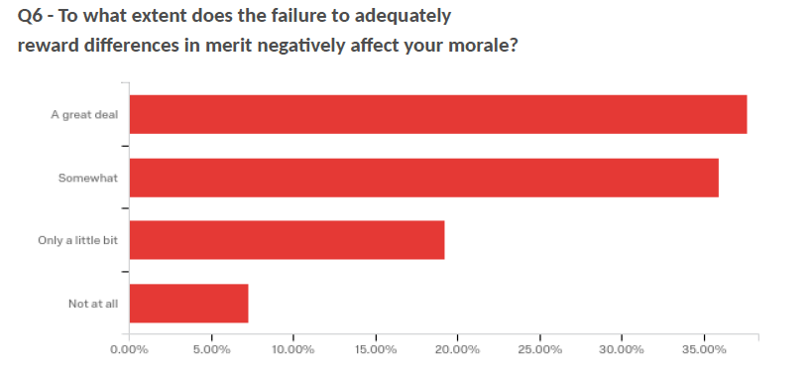
Morale

Slide 7
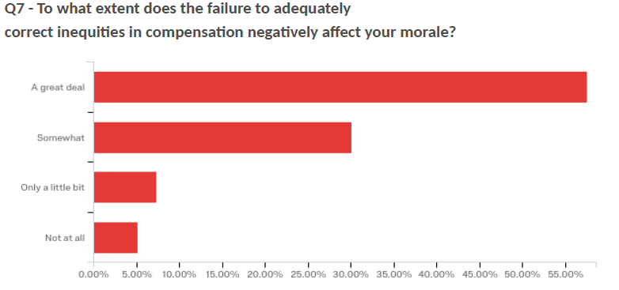
Morale

Slide 8
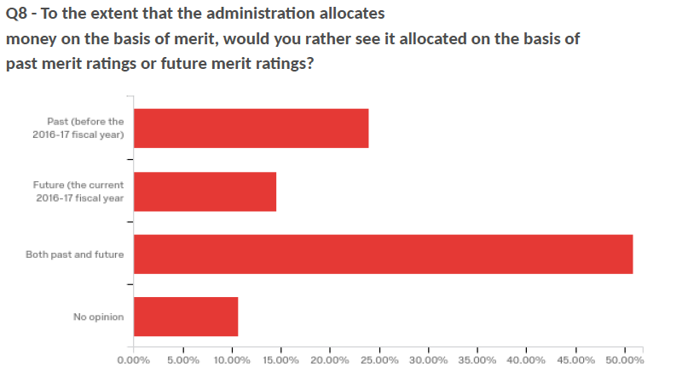
Merit: Past vs. Future

Slide 9
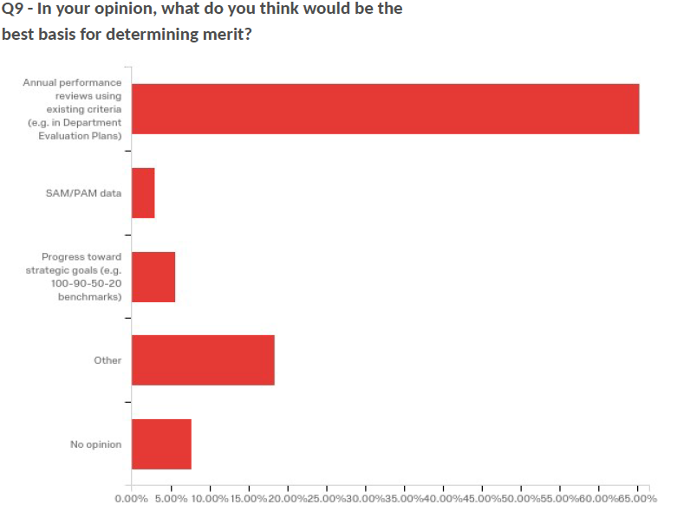
Merit: Basis of Measurement

Slide 10
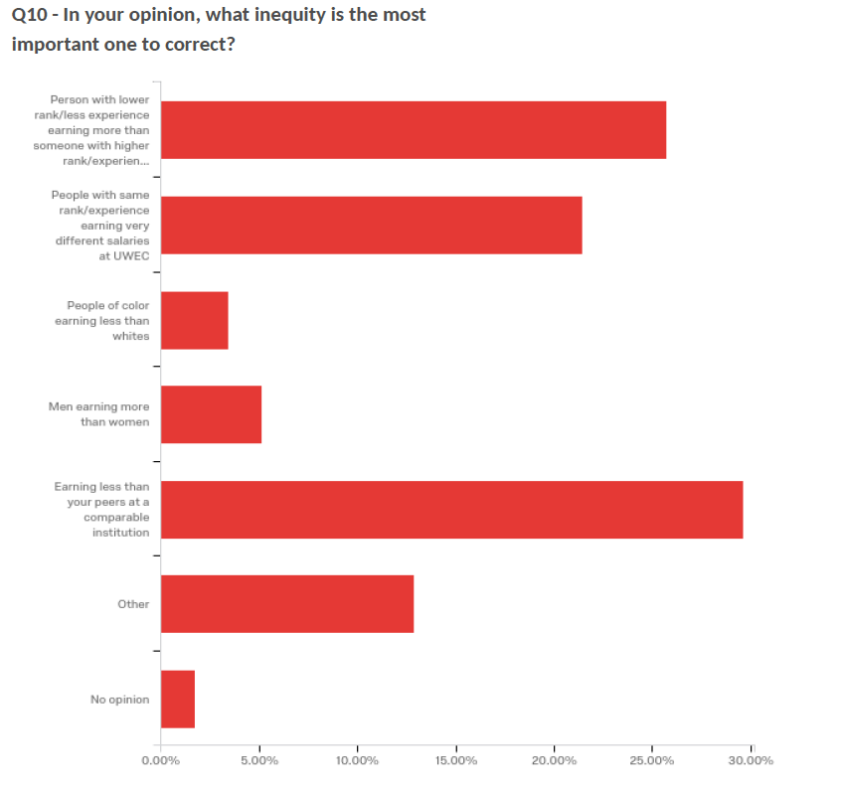
Inequity—most important

Slide 11
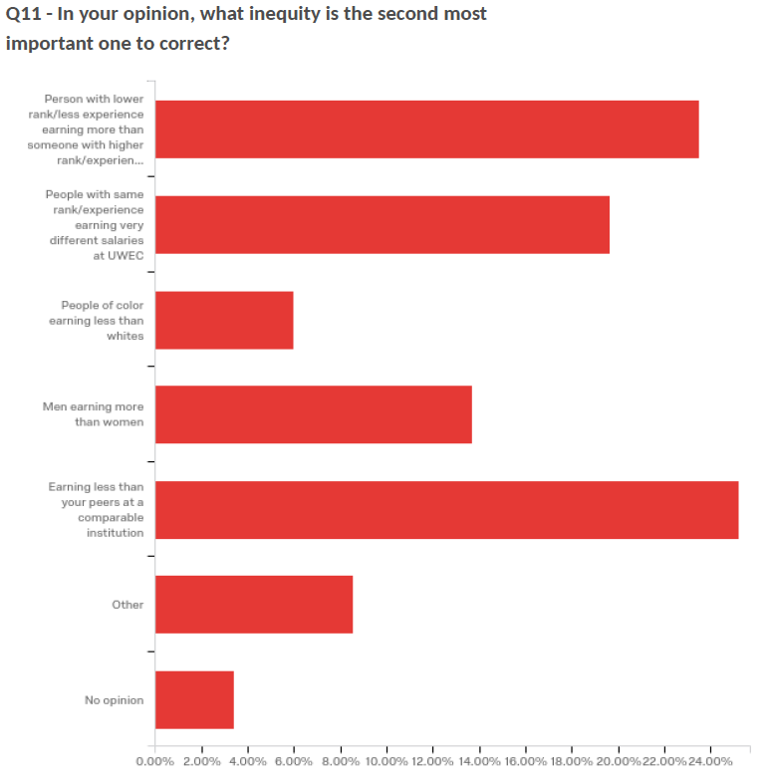
Inequity—2nd most important

Slide 12
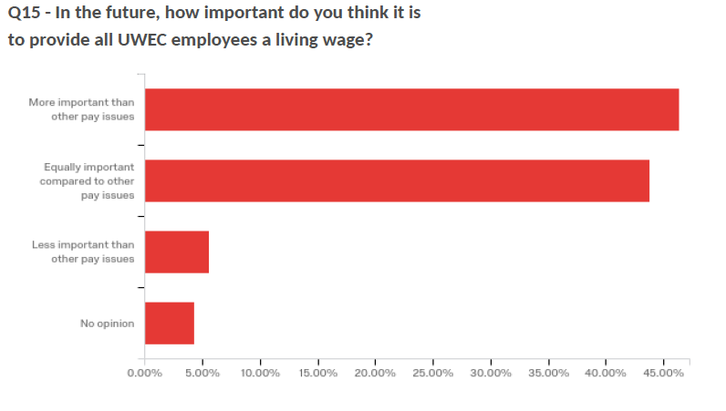
Living Wage

Slide 13
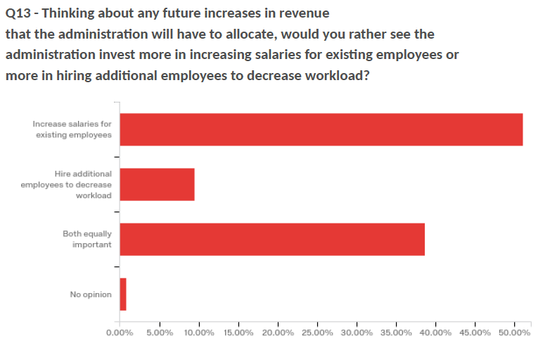
Future Allocations

Slide 14
Future Allocations

Slide 15
Motion for Discussion
On the basis of these survey results, the United Faculty and Academic Staff of the University of Wisconsin-Eau Claire recommends to the Strategic Merit and Equity Committees:
That 50% of the $3 million be allocated on the basis of merit, as measured by annual performance reviews from both current (2016) and previous calendar years
That 50% of the $3 million be allocated on the basis of equity, prioritizing:
Providing wage increases for lowest-paid employees and bring them in line with the Eau Claire County living wage ordinance
Addressing inequities in cases where employees at a lower rank earn more than their colleagues at higher ranks, and reducing compression at the ranks of associate and full professor
Reducing inequities between University and Academic Staff who have the same rank and experience while performing the same job
That these allocations should be made in January 2017 ($750K for merit, $750K for equity) and carried over into the 2017-18 fiscal year.
We further recommend that considerations of merit and equity include those Academic and University Staff who, as part of the 2015-16 institutional restructuring, took on additional work with no equivalent change in pay or title.

