Slide 1
2019 Academic staff/Faculty survey on working conditions
United faculty and academic staff of UWEC
AFT 6481

Slide 2
Methodology
Email survey to all faculty and academic staff, n = 848 (from employee list Feb. 15, 2019)
Survey dates: February 22-March 1
Completed responses (n = 290); response rate = 34%
Partial responses (n = 11)
Analysis: Focus on employee classification; inequalities in race, ethnicity, gender, sexual orientation better documented elsewhere

Slide 3
Outline
Demographics
Satisfaction
Experiences, Emotions, and Concerns
Discrimination
Changes and Improvements
Conclusion

Slide 4
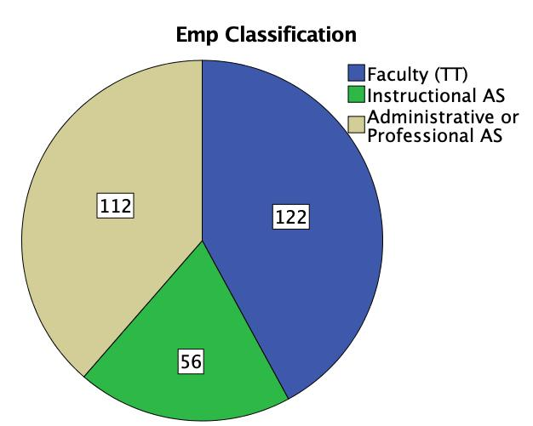
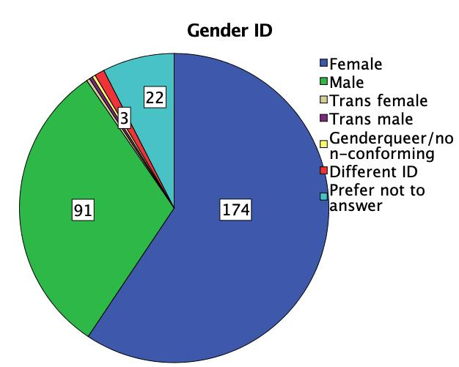
Who took the survey?
33.0% of Faculty
33.6% of AS
Excludes “Limited” & “University Staff”

Slide 5
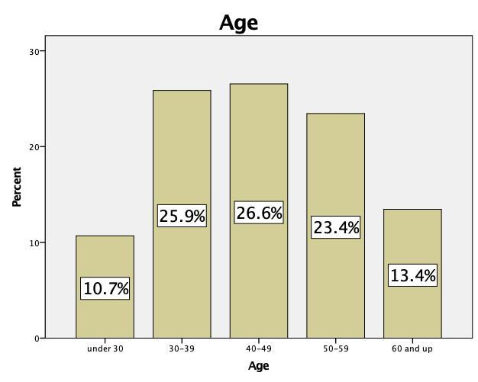
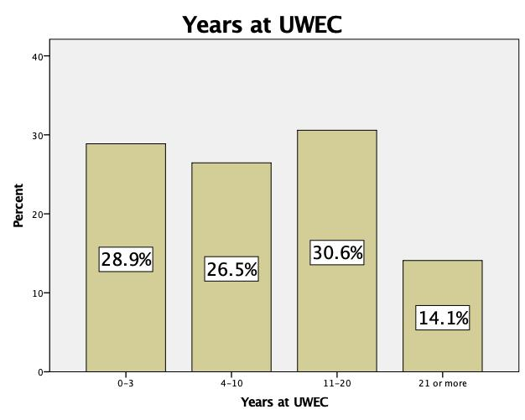
Who took the survey?

Slide 6
Who took the survey?
Race/Ethnicity | % Selecting
White/Caucasian | 81.4%
Hispanic/Latinx | 2.7%
Asian/Pacific Islander | 2.0%
Black/African-American | 1.3%
Native American/American-Indian | 1.0%
Other | 1.7%
Prefer not to answer | 10.3%

Slide 7
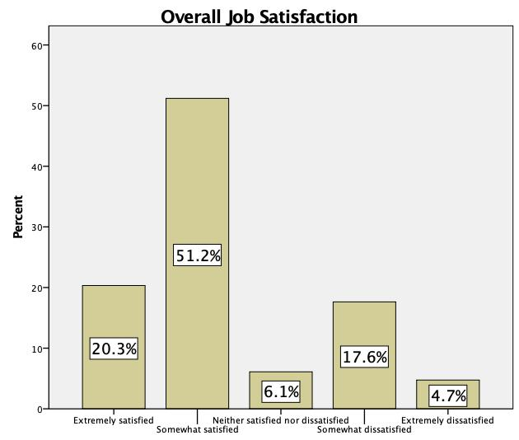
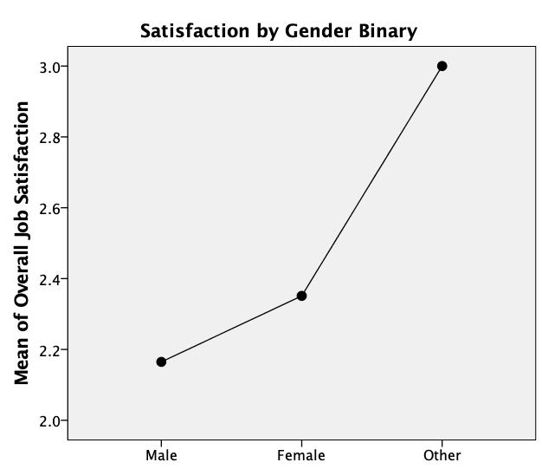
(Dis)satisfaction
5 = Extremely dissatisfied
No statistical difference by employee category, race

Slide 8
(Dis)satisfaction by issue by employee Category
Aspect | Mean | More Dissatisfied
Salary/Wages** | 3.0 | IAS vs. others
Benefits*** | 2.1 | APAS vs. faculty
Job Security*** | 2.4 | IAS vs. others
Workload** | 3.0 | Faculty vs. APAS
Physical Work Environment | 2.5
Social Climate | 2.5
Having Voice Heard | 3.0
Opportunities for Promotion/Advancement*** | 3.0 | All academic staff vs. faculty
5 = Extremely dissatisfied
**One-way ANOVA F-Test, Group differences statistically significant at p<.05
***One-way ANOVA F-Test, Group differences statistically significant at p<.01

Slide 9
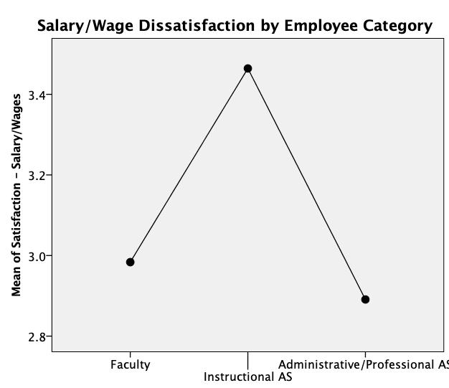
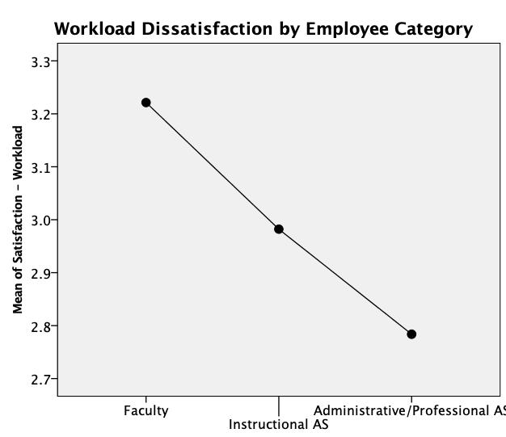
(Dis)satisfaction by issue by employee Category

Slide 10
Experiences
Experience | Mean | More Often
Work praised by supervisor | 3.1
Given additional work responsibilities** | 3.2 | APAS vs. IAS
Earning a promotion*** | 2.1 | Faculty vs. others
Working without contract/appointment letter*** | 1.9 | IAS vs. others
Feeling harassed or uncomfortable | 1.8
Feeling emotionally supported | 3.6
Unclear communication** | 2.9 | APAS vs. others
Micro-managed or excessively scrutinized | 2.3
Yelling, inappropriate comments, bullying | 1.5
1= Never; 5 = Always
**One-way ANOVA F-Test, Group differences statistically significant at p<.05
***One-way ANOVA F-Test, Group differences statistically significant at p<.01

Slide 11
emotions
Feeling | Mean | Less Often
Happy | 3.5
Bored** | 2.1 | (almost IAS vs. APAS)
Frustrated | 3.3
Overwhelmed | 3.3
Excited*** | 3.3 | APAS vs. others
Fulfilled*** | 3.4 | APAS vs. others
Worried | 3.0
1= Never; 5 = Always
**One-way ANOVA F-Test, Group differences statistically significant at p<.05
***One-way ANOVA F-Test, Group differences statistically significant at p<.01

Slide 12
Concerns
Concern about... | % “Yes” | More Often
Uninformed about promotion opportunities*** | 37
Being misclassified*** | 24
Being underpaid | 79
Being overpaid | 3
Asked to do something unethical** | 13 | APAS vs. IAS
Unfair treatment | 40
Unsafe working conditions | 16
Hostile workplace | 30
**One-way ANOVA F-Test, Group differences statistically significant at p<.05
***One-way ANOVA F-Test, Group differences statistically significant at p<.01

Slide 13
discrimination
On basis of | Mean | Experienced by
Age*** | 1.8 | APAS vs. faculty; very young and very old vs. 40-49; Female and non-binary vs. male
Sex/Gender | 1.9 | Female and non-binary vs. male
Ability/Disability | 1.2 | 21+years at UWEC vs 0-3 years at UWEC
Veteran Status | 1.0
Race/Ethnicity | 1.3 | Person of color & No answer vs. white; Non-binary vs. others
Job Title/Occupational Status*** | 1.8 | All AS vs. faculty; female vs. male
Sexual Orientation | 1.1 | Non-binary vs. others
Religious Beliefs | 1.3 | Non-binary vs. others
Political Beliefs | 1.3 | Non-binary vs. others; No answer vs. other races
Income/Class | 1.3 | Non-binary vs. male
Where you live | 1.2
1 = Never, 5 = Almost all the time
**One-way ANOVA F-Test, Group differences statistically significant at p<.05
***One-way ANOVA F-Test, Group differences statistically significant at p<.01

Slide 14
Top 5 Improvements to Morale
All | Faculty | IAS | APAS
Salary/Wage increase (78) | Salary/Wage increase (30) | Salary/Wage increase (20) | Salary/Wage increase (27)
Reduced pay inequities (31) | Reduced pay inequities (14) | More job security (15) | More flexibility in working hours (10)
More job security (26) | More diversity on campus (14) | Reduced pay inequities (7) | Reduced pay inequities (9)
Better health insurance benefits (20) | Better health insurance benefits (9) | Better health insurance benefits (4) | More support, assistance, training (8)
More diversity on campus (18) | More say over campus governance (7) | More support, assistance, training (4) | Four-way tie (7)—freedom, health insurance, campus governance, job security
Other: “reduce workload;” “better communication and support;”
“less complaining; “better parking options; “supervisor accountability”

Slide 15
Top 5 Policy Changes
All | Faculty | IAS | APAS
Tuition benefit (114) | Tuition benefit (45) | Tuition benefit (19) | Tuition benefit (50)
Free/cheaper parking (103) | Free/cheaper parking (34) | Free/cheaper parking (19) | Free/cheaper parking (48)
Paid parental leave (49) | Paid parental leave (17) | Multi-year employment contracts (12) | Paid parental leave (24)
Additional promotion opportunities (35) | Restoration of full tenure (27) | Additional promotion opportunities (10) | Additional promotion opportunities (20)
Restoration of powers of shared governance (35) | Restoration of powers of shared governance (21) | Paid parental leave (8) | Multi-year employment contracts (13)
Other: “Addressing the still apparent ‘good ole boys club’;” “more manageable workload;” “ability to work from home more often;” “better attention to handicap needs—parking is a travesty;” “actual longterm job for academic staff”

Slide 16
What one change to your job or workplace do you think would make the biggest improvement in your overall job satisfaction?
10 single-spaced pages of text
7 single-spaced pages of “other comments or concerns”

Slide 17
conclusion
Overall satisfaction—things are good here, but not for everyone
Longstanding climate, equity, and discrimination problems on basis of gender, race, and ethnicity
We all desire better pay and a climate of respect, fairness, and transparency
 | Biggest Grievances | Real Solutions?
Faculty | Workload Pay inequity | More resources for teaching & scholarship/creativity
Instructional Academic Staff | Job security Lack of promotion/advancement | Multi-year contracts Pathways to tenure track
Administrative/Professional Academic Staff | Vulnerability to supervisors and their demands (“put upon”) Lack of promotion/advancement | Supervisor accountability Protections against firing Support professional development

